Slide 1
AREIX Data Bootcademy Portfolio Optimization - MPF Scheme Returns Prediction Using Machine Learning in Quantitative Trading
Analyst:
LEE Chi Chung, John

Slide 2

1. Helping with Your Problem
Our solution for you
Performance & Benchmarking
What it means for you
2. Analysis of Your MPF Scheme
Principal MPF Scheme Series 800
Fund Performance
3. How to Best use our Model
3 Functions of our Model
3 Edges of our Model
4. Scientific Basis of Model
Efficient Frontier
Backtesting and Optimization

Slide 3
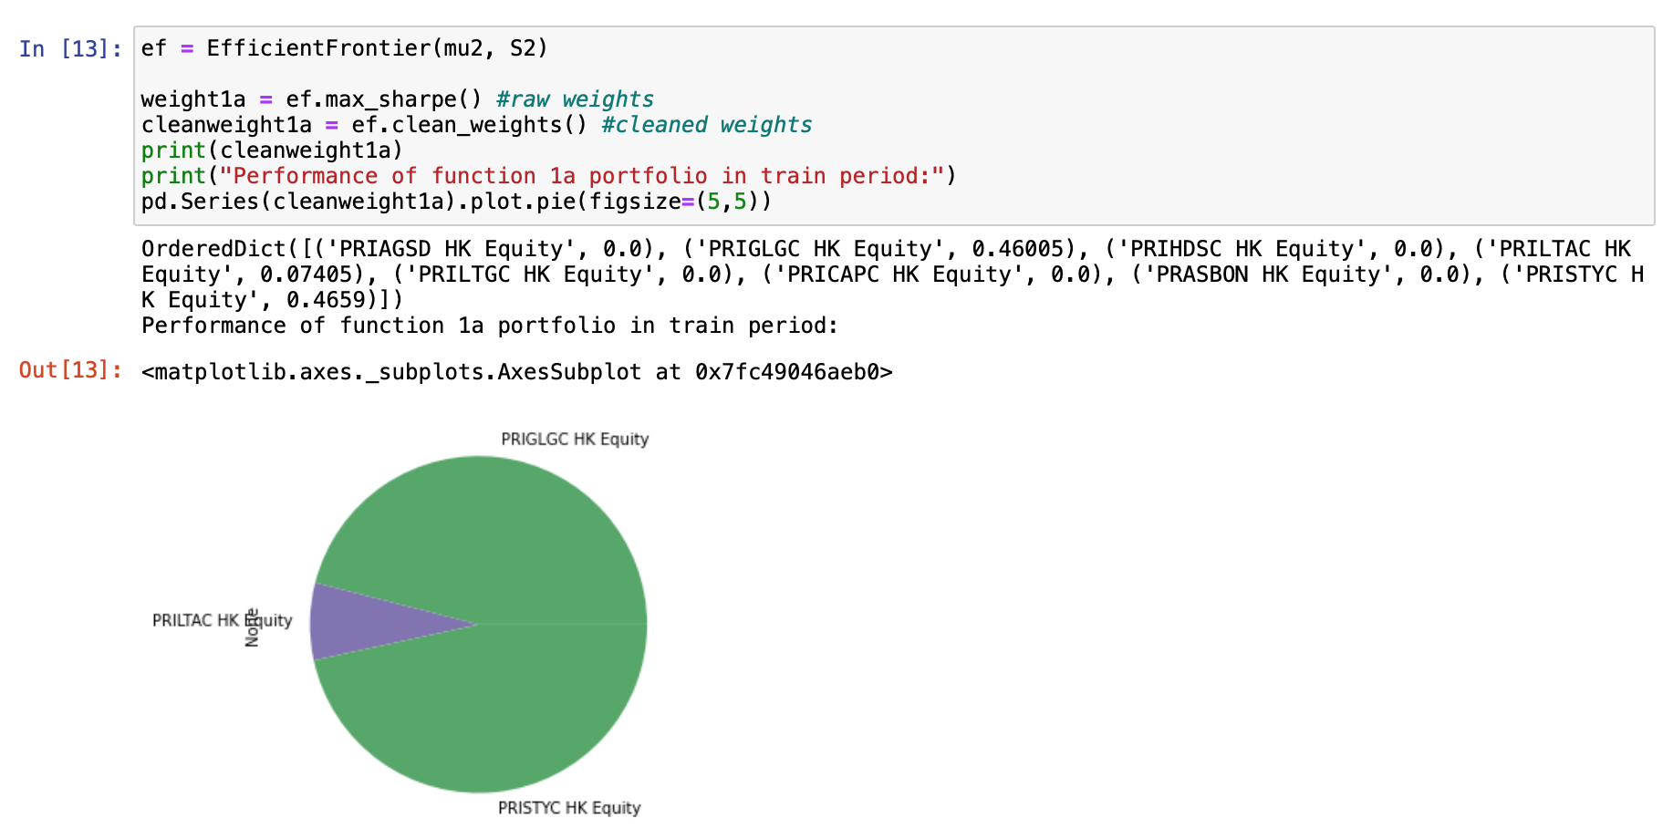
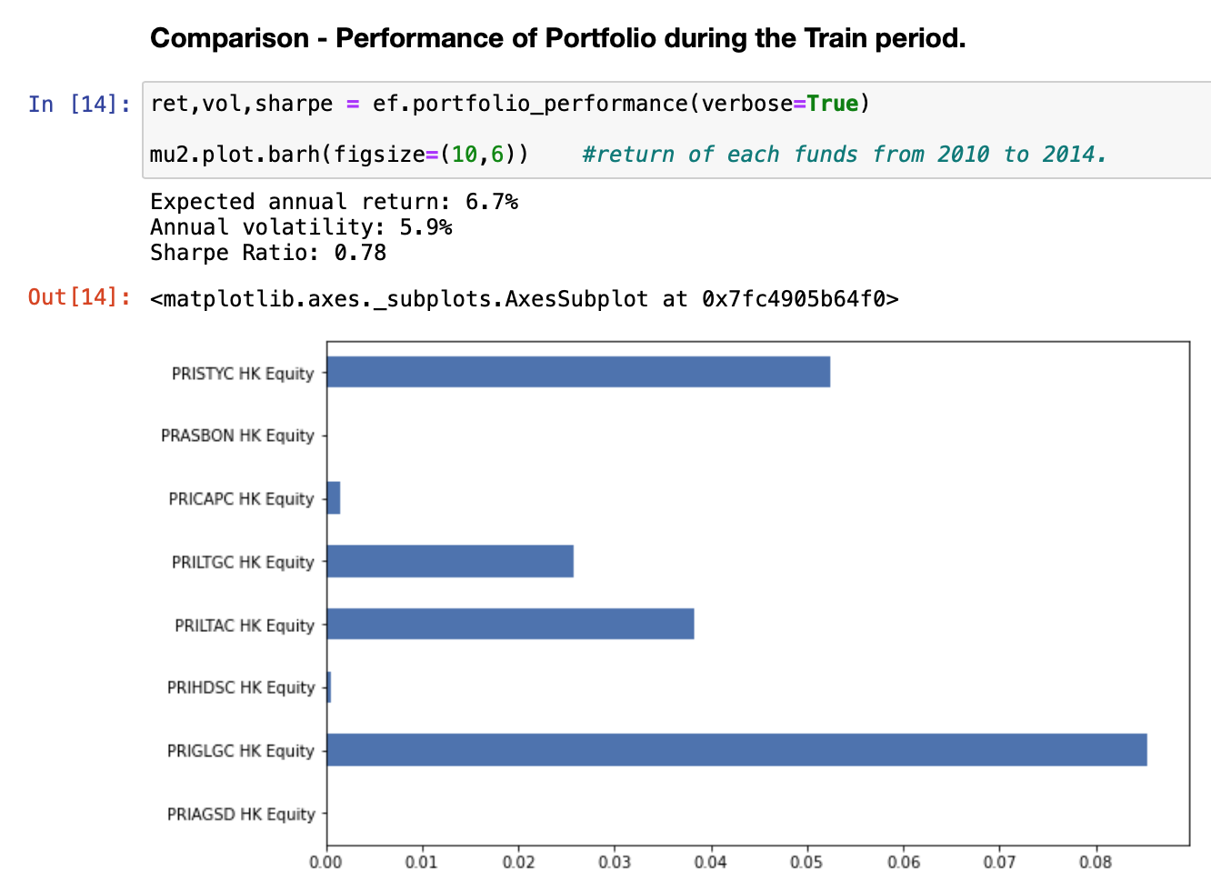
Our solution for you
Purpose
Build a Portfolio with funds within the MPF Scheme in Principal with modeling
Beat the benchmark (Default Investment Strategy)

Slide 4
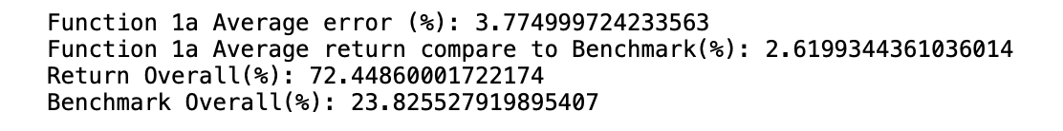
Performance & Benchmarking
Overall
Average Error of Test data vs. Validation Data: <5%
Average annualized return compare to benchmark: +2.62%
Return over 20 years compare to benchmark: ~50%!

Slide 5
Our solution for you
Overall return
But why?

Slide 6

Principal

Slide 7



Principal
3 MPF Scheme
Series 800
Smart Plan
Simple Plan

Slide 8
Fund List
Fund List
Fund Initial | Fund Name
PRIAGSD HK Equity | Principal MPF Scheme Series 800 - Aggressive Strategy Fund
PRSSCOA HK Equity | Principal MPF Scheme Series 800 - Principal Core Accumulation Fund
PRIGLGC HK Equity | Principal MPF Scheme Series 800 - Global Growth Fund
PRIHDSC HK Equity | Principal MPF Scheme Series 800 - HK Dollar Savings Fund
PRILTAC HK Equity | Principal MPF Scheme Series 800 - Long Term Accumulation Fund
PRILTGC HK Equity | Principal MPF Scheme Series 800 - Long Term Guaranteed Fund
PRICAPC HK Equity | Principal MPF Scheme Series 800 - MPF Conservative Fund
PRASBON HK Equity | Principal MPF Scheme Series 800 - Principal Asian Bond Fund
PRISTYC HK Equity | Principal MPF Scheme Series 800 - Stable Yield Fund

Slide 9
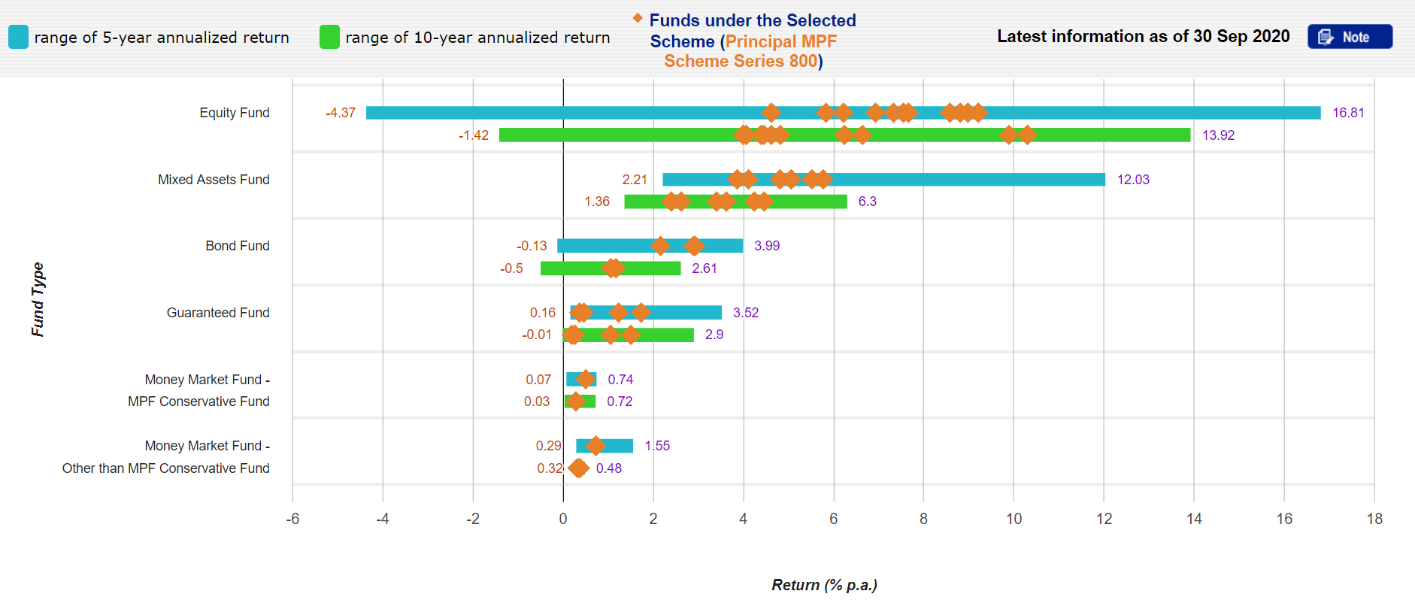
Fund Performance
Annualized Return by Categories

Slide 10
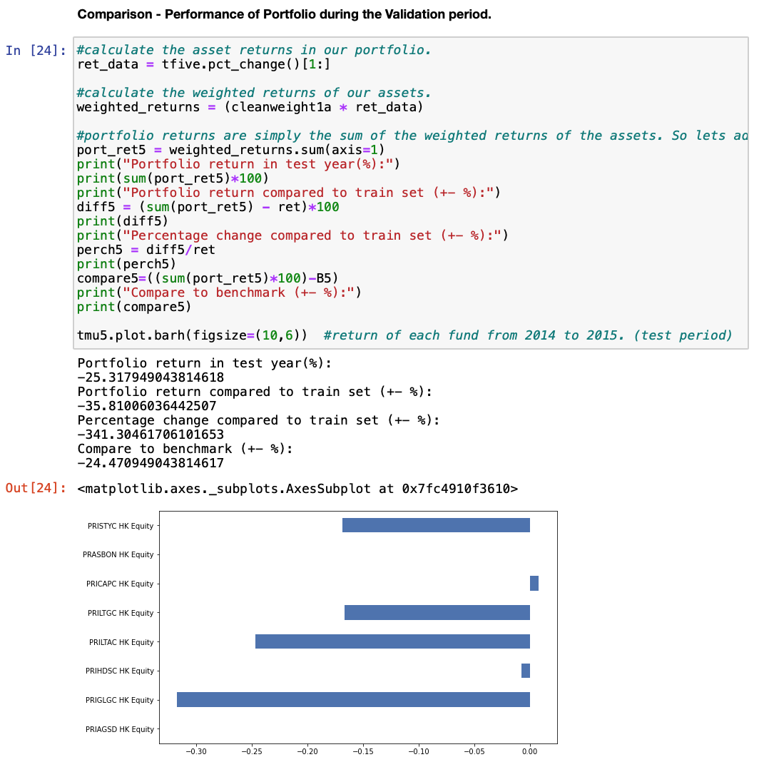
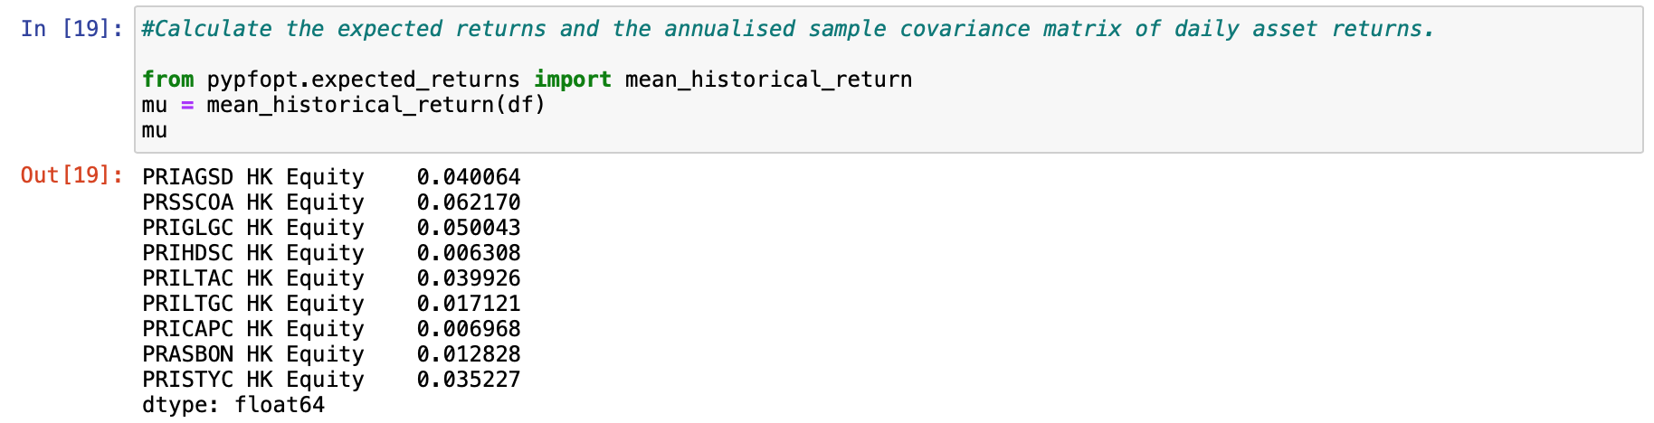
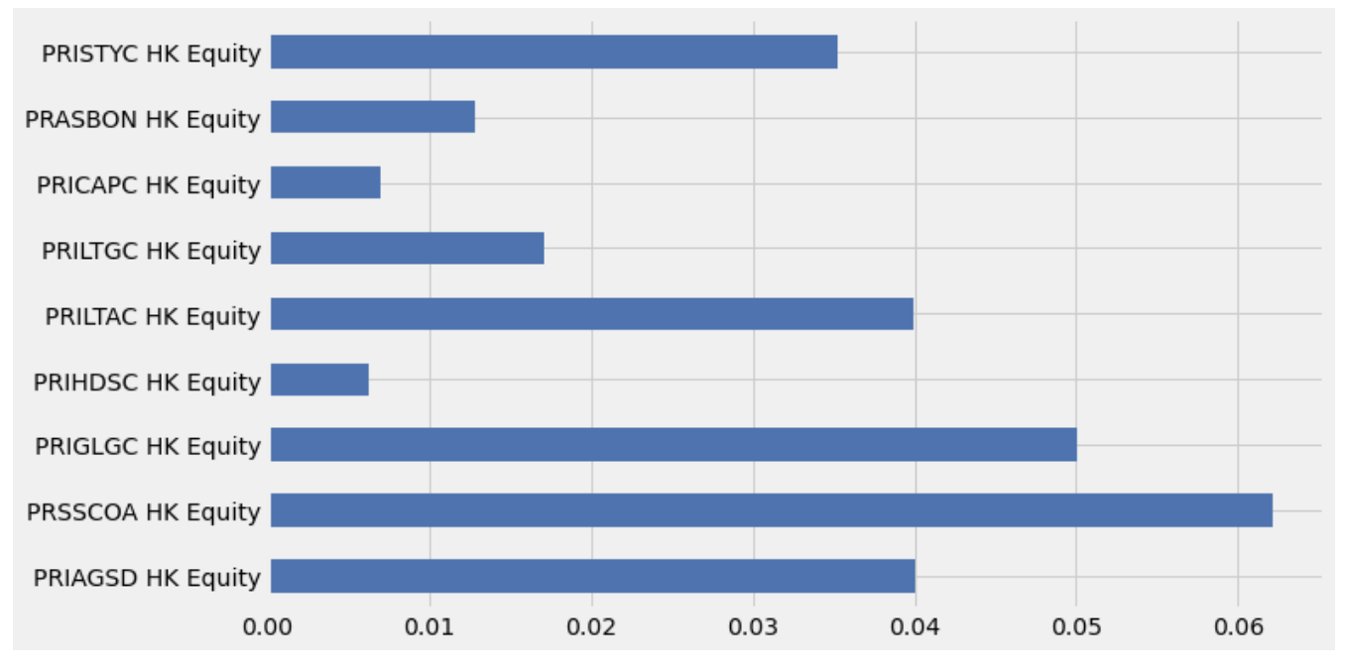
Fund Performance
Annualized Return by Fund

Slide 11
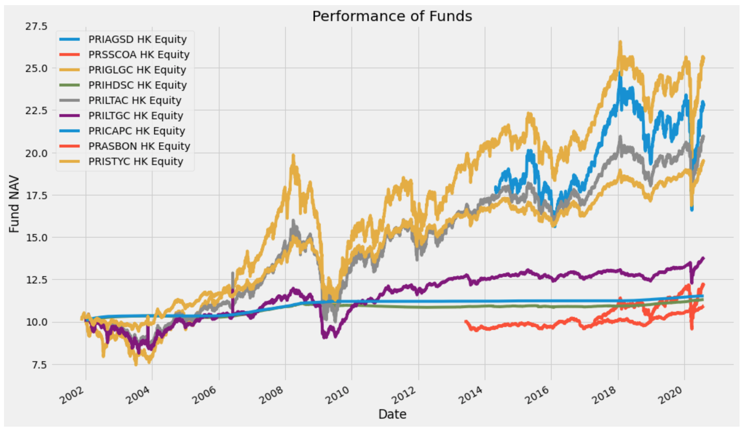
Fund Performance
Fund NAV
PRASBON HK Equity
Launched 2013
PRIAGSD HK Equity
Launched 2014
PRSSCOA HK Equity
Launched 2017

Slide 12
Functions

Slide 13
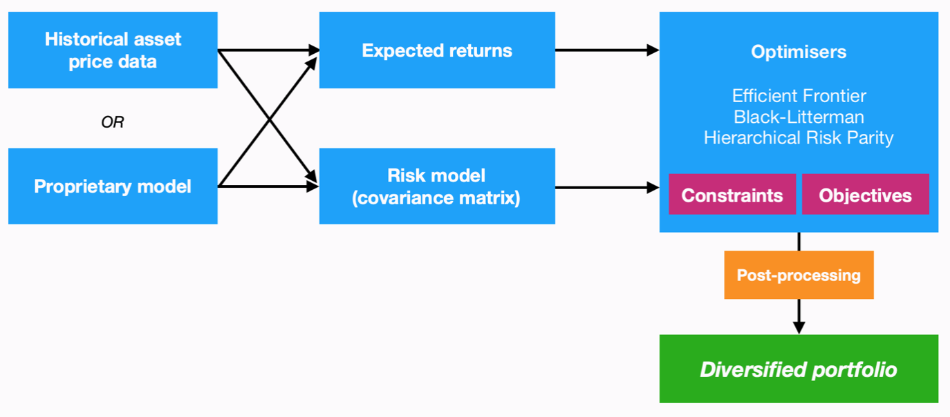
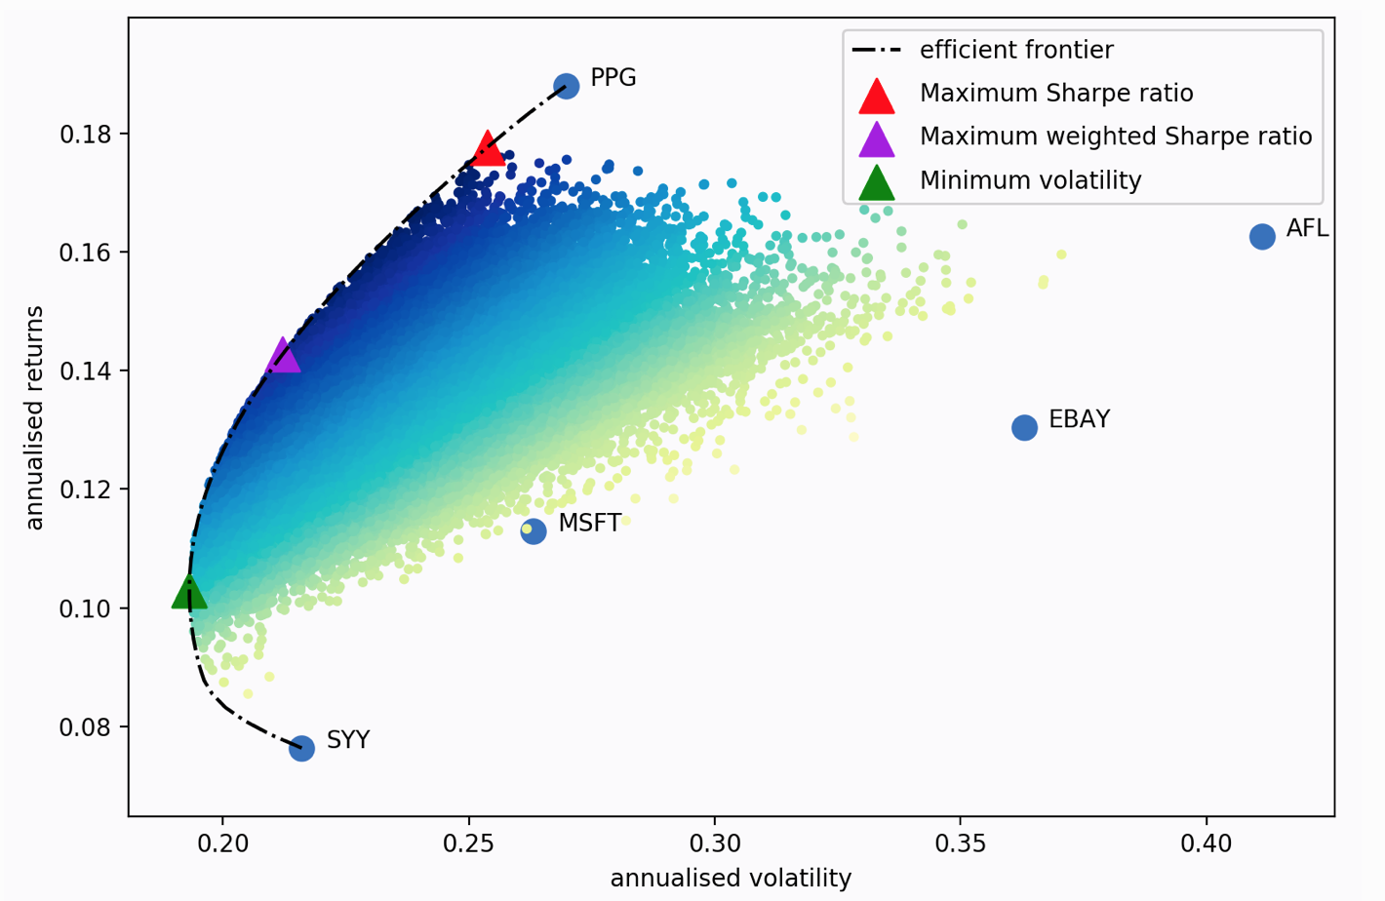
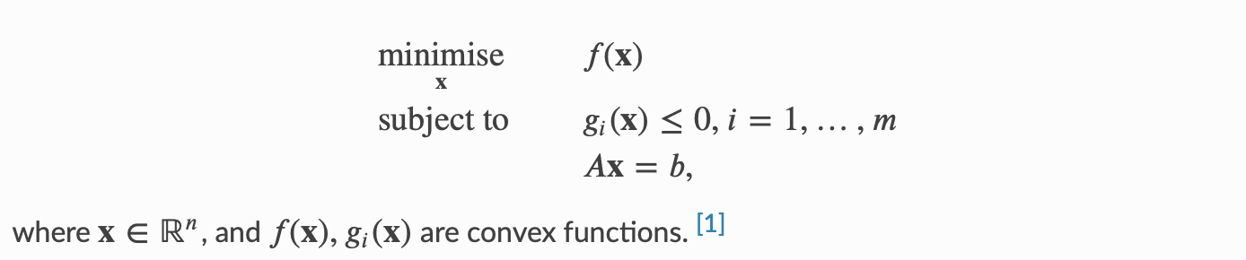
Efficient Frontier Optimisation

Slide 14
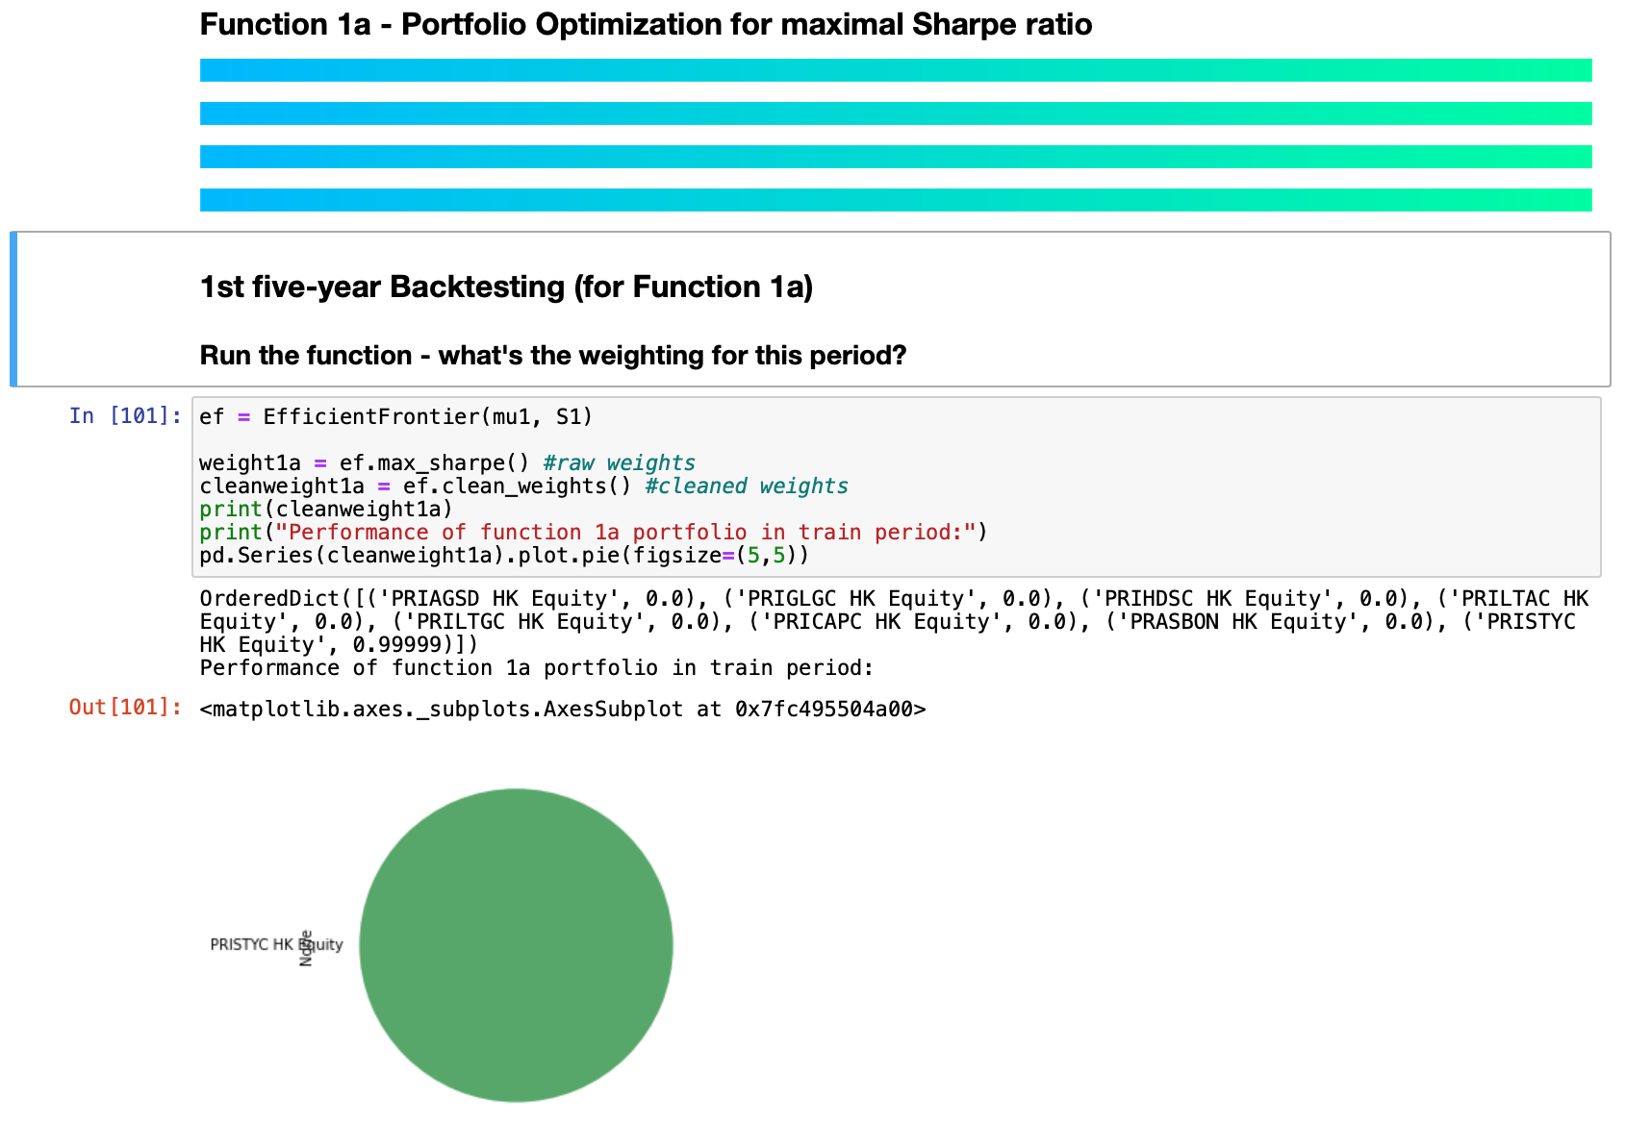
Function 1a
Maximize Sharpe Ratio

Slide 15
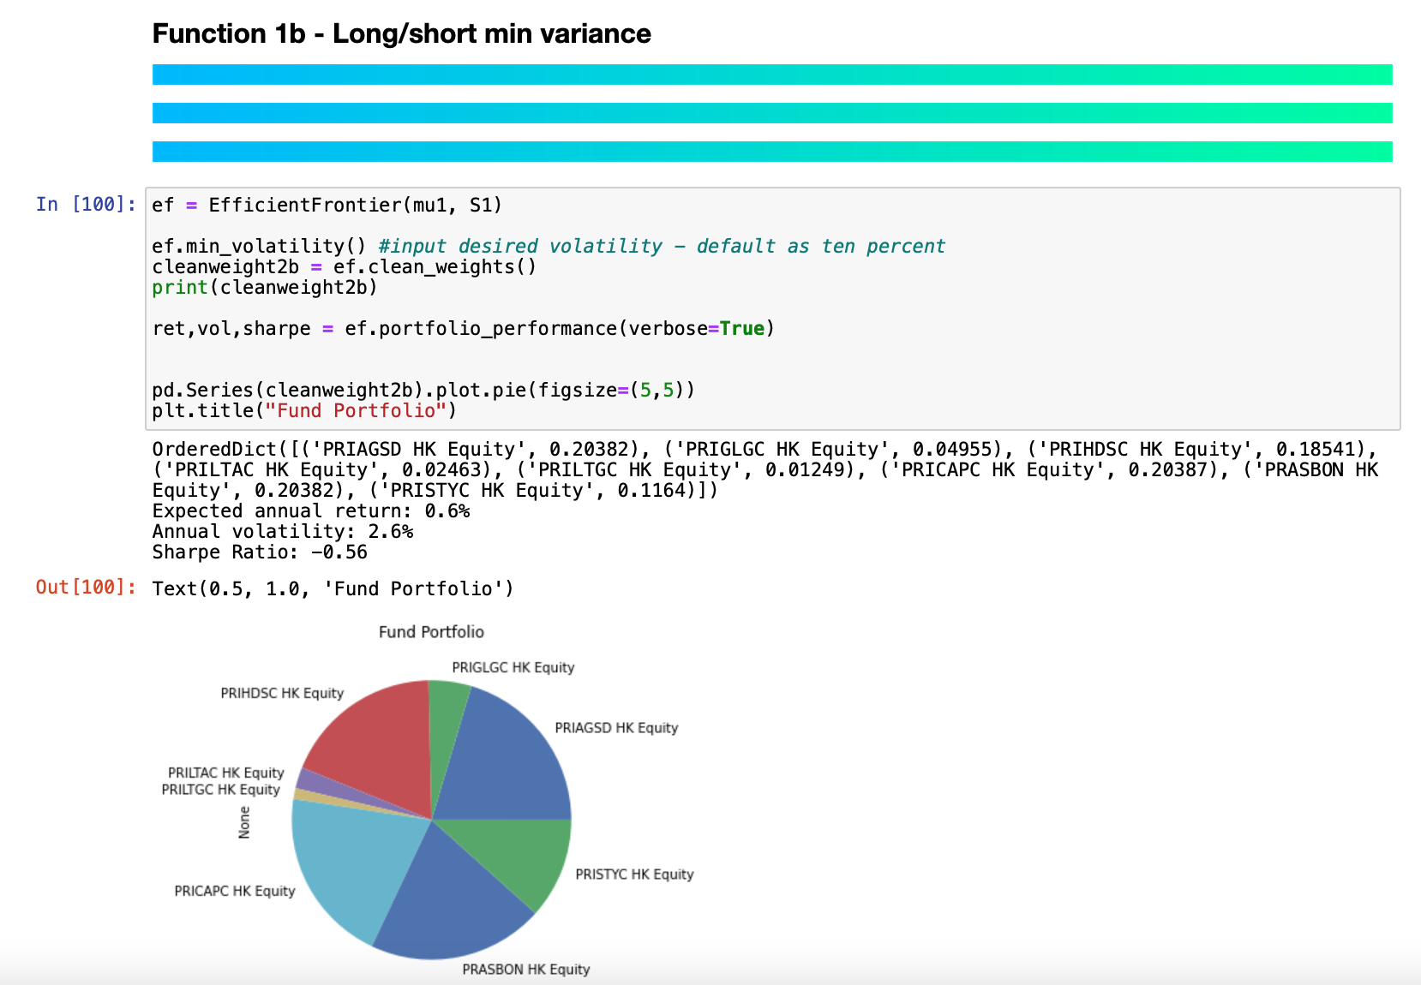
Function 1b
Minimize variance

Slide 16
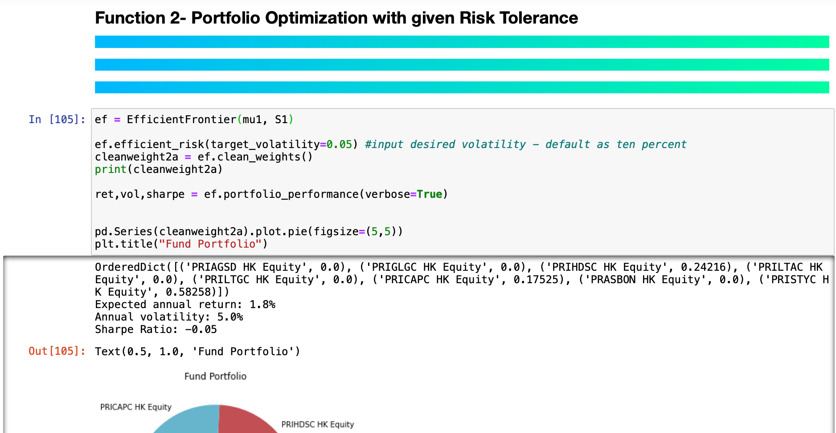
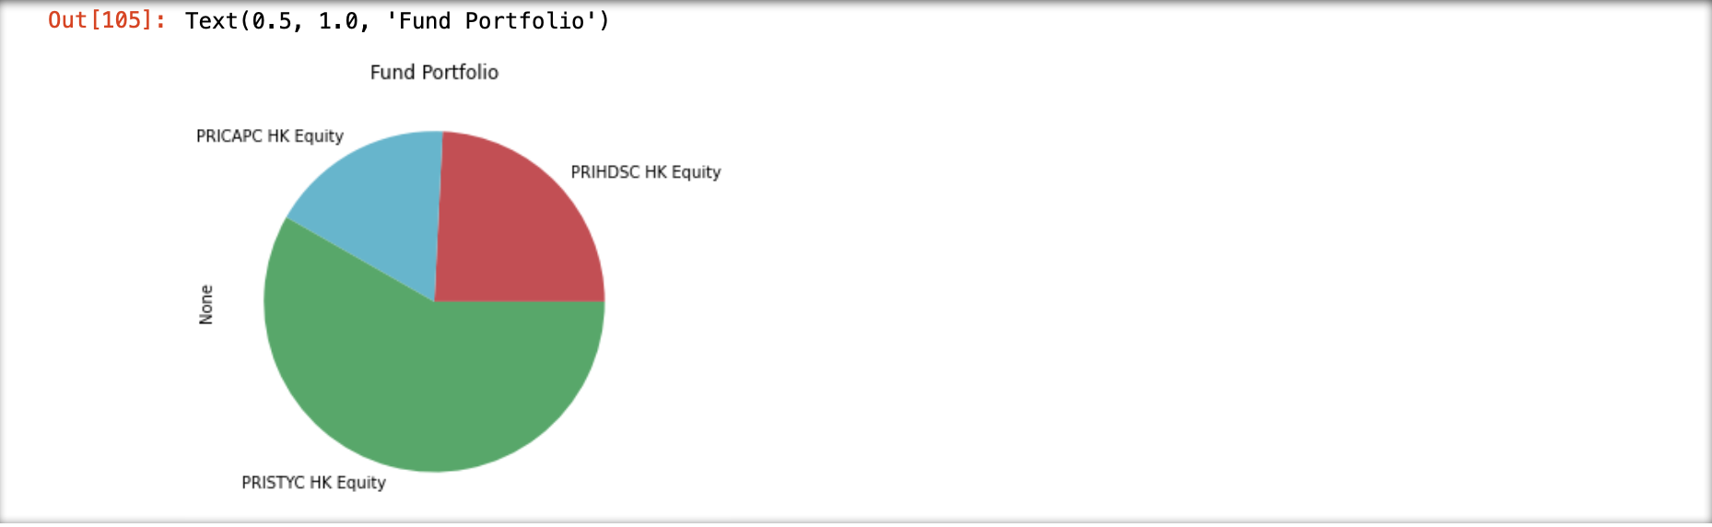
Function 2
Given Target Risk Tolerance

Slide 17
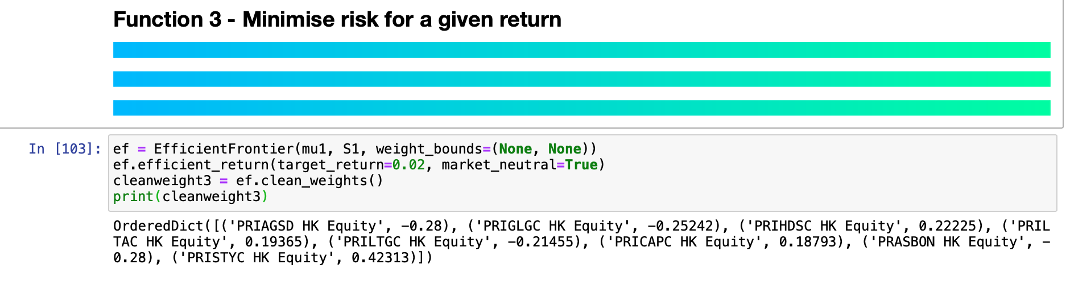
Function 3
Given Target Return

Slide 18
Scientific Basis of Model

Slide 19
Backtesting and Optimization
Benchmark and Dropped Fund
Default Investment Strategy
PRIHDSC HK Equity – 2001-2017
PRSSCOA HK Equity – 2017-2020
Dropped - PRSSCOA HK Equity
5/4/2017
3 years

Slide 20
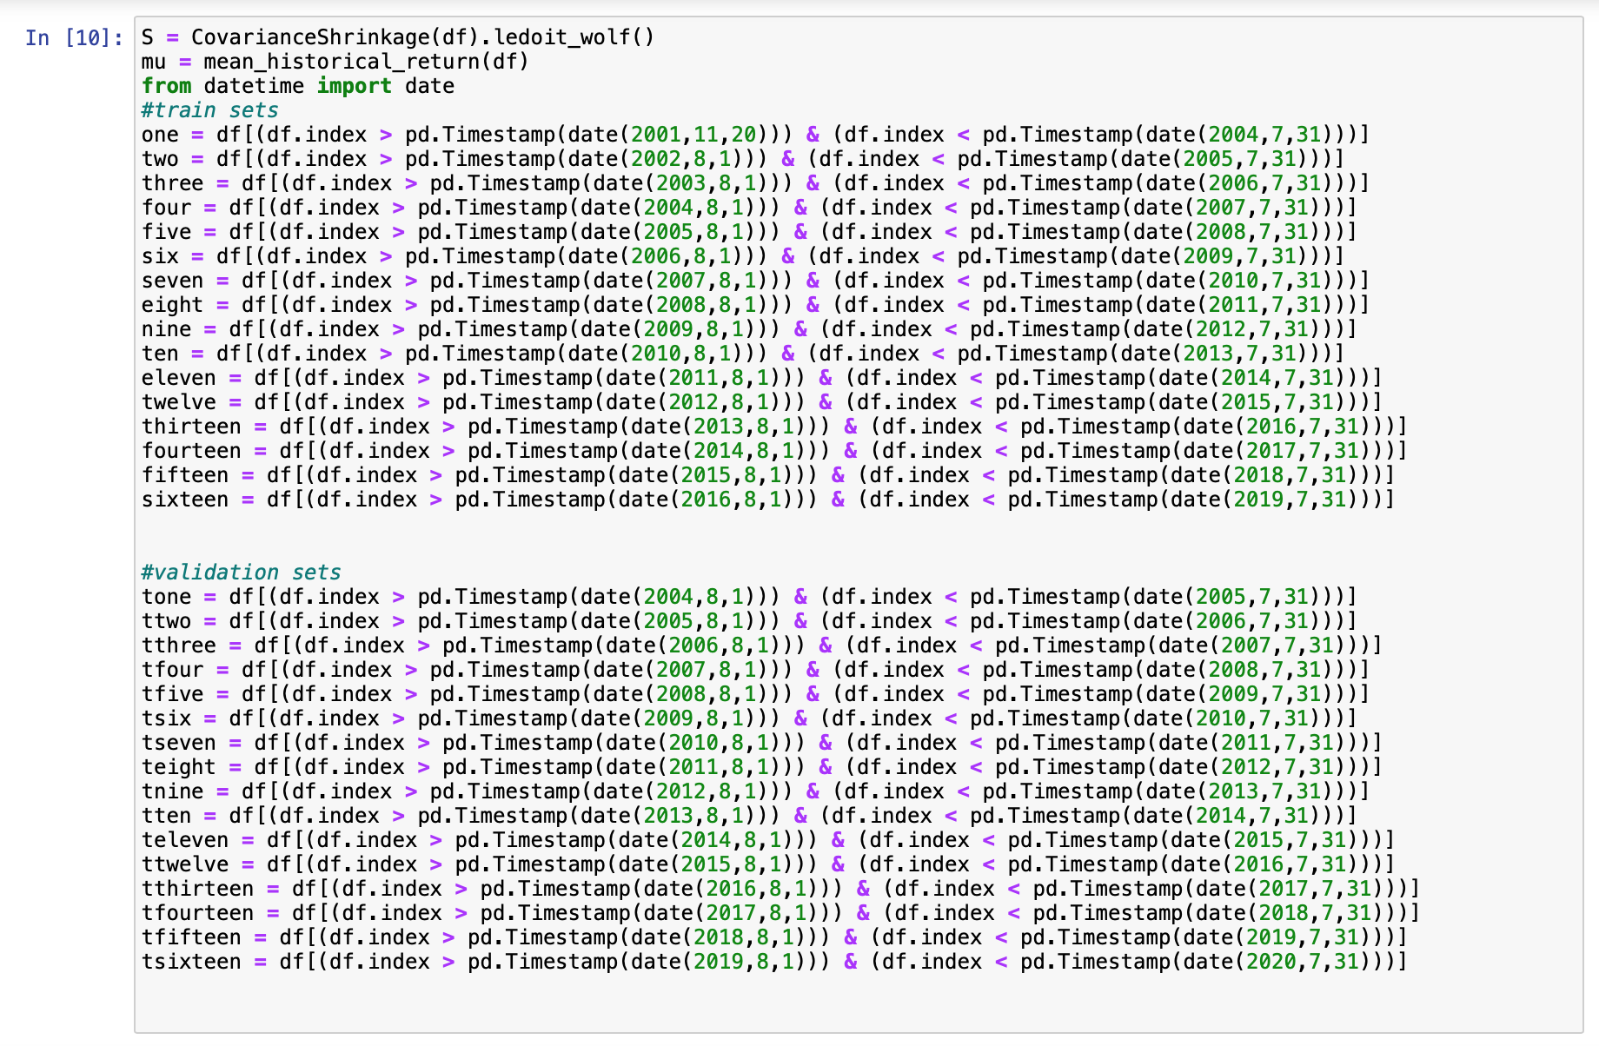
Backtesting and Optimization
4 years back testing
3-year training data
1-year validation data
e.g. 2001-2004 training
2004-2005 validation
16 windows in total

Slide 21
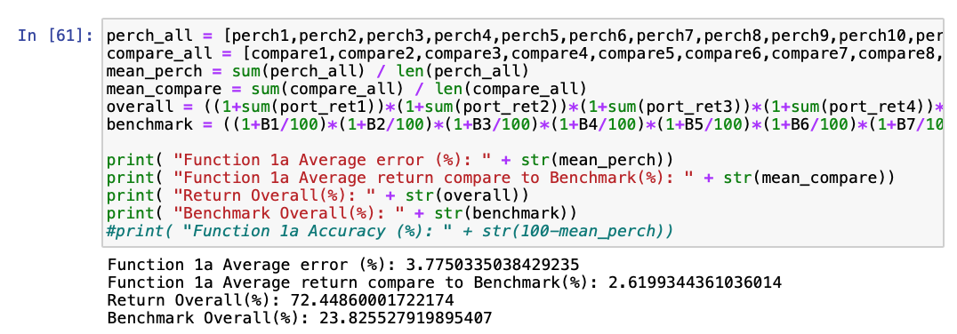
Statistic Analysis
20 years data
Average error - 3.78%
Windows – 16 windows - Adequate
Includes the financial crisis between 2000-2020
A fit model!

Slide 22
Portfolio - Max Sharpe Ratio
Statistic (1)
Training Period | Validation Period | Portfolio | Expected Return (Training) | Volatility (Training) | Sharpe Ratio (Training) | Actual Return (Validation) | Difference (Expected) | Benchmark | Difference (Benchmark)
2001/11/20 - 2004/07/31 | 2004/08/01 - 2005/07/31 | PRISTYC HK Equity: 100% | 2.3% | 8.0% | 0.04 | 8.50% | 6.17% | -0.649% | 9.15%
2002/08/01 - 2005/07/31 | 2005/08/01 - 2006/07/31 | PRISTYC HK Equity: 46.59%; PRIGLGC HK Equity: 46.005%; PRILTAC HK Equity: 7.405% | 6.7% | 5.9% | 0.78 | 9.30% | 2.64% | 1.224% | 8.07%
2003/08/01 - 2006/07/31 | 2006/08/01 - 2007/07/31 | PRIGLGC HK Equity: 56.002%; PRISTYC HK Equity: 37.415%; PRILTAC HK Equity: 6.583% | 12.7% | 5.9% | 1.81 | 13.70% | 1.01% | 3.503% | 10.93%
2004/08/01 - 2007/07/31 | 2007/08/01 - 2008/07/31 | PRIGLGC HK Equity: 63.86%; PRISTYC HK Equity: 33.388%; PRILTAC HK Equity: 2.752% | 12.9% | 5.6% | 1.95 | 10.44% | -2.49% | 2.763% | 7.68%
2005/08/01 - 2008/07/31 | 2008/08/01 - 2009/07/31 | PRIGLGC HK Equity: 50.291%; PRISTYC HK Equity: 37.987%; PRIHDSC HK Equity: 6.384% PRICAPC HK Equity: 5.338% | 10.5% | 5.7% | 1.50 | -25.32% | -35.81% | -0.847% | -24.47%
2006/08/01 - 2009/07/31 | 2009/08/01 - 2010/07/31 | PRICAPC HK Equity: 100% | 2.3% | 0.9% | 0.29 | 0.00804% | -2.25% | -0.073% | 0.081%
2007/08/01 - 2010/07/31 | 2010/08/01 - 2011/07/31 | PRISTYC HK Equity: 100% | 2.9% | 8.3% | 0.11 | 10.90% | 8.01% | -0.585% | 11.50%
2008/08/01 - 2011/07/31 | 2011/08/01 - 2012/07/31 | PRISTYC HK Equity: 71.434%; PRILTAC HK Equity: 28.566% | 3.0% | 7.3% | 0.14 | -5.34% | -8.34% | -0.150% | -5.19%

Slide 23
Portfolio - Max Sharpe Ratio
Statistic (2)
Training Period | Validation Period | Portfolio | Expected Return (Training) | Volatility (Training) | Sharpe Ratio (Training) | Actual Return (Validation) | Difference (Expected) | Benchmark | Difference (Benchmark)
2009/08/01 - 2012/07/31 | 2012/08/01 - 2013/07/31 | PRILTGC HK Equity: 86.875%; PRISTYC HK Equity: 13.125% | 8.5% | 3.6% | 1.79 | 1.24% | -7.24% | 0.364% | 0.88%
2010/08/01 - 2013/07/31 | 2013/08/01 - 2014/07/31 | PRISTYC HK Equity: 62.051%; PRIGLGC HK Equity: 37.949% | 3.6% | 6.6% | 0.24 | 10.26% | 6.70% | 0.044% | 10.22%
2011/08/01 - 2014/07/31 | 2014/08/01 - 2015/07/31 | PRIAGSD HK Equity: 99.642%; PRISTYC HK Equity: 0.358% | 18.1% | 2.0% | 8.22 | 1.83% | -16.22% | 0.374% | 1.46%
2012/08/01 - 2015/07/31 | 2015/08/01 - 2016/07/31 | PRIGLGC HK Equity: 81.216%; PRISTYC HK Equity: 18.784%; | 8.0% | 6.5% | 0.93 | -0.72% | -8.72% | -0.387% | -0.34%
2013/08/01 - 2016/07/31 | 2016/08/01 - 2017/07/31 | PRIGLGC HK Equity: 100% | 3.4% | 8.7% | 0.16 | 14.12% | 10.71% | 0.295% | 13.82%
2014/08/01 - 2017/07/31 | 2017/08/01 - 2018/07/31 | PRIAGSD HK Equity: 100% | 4.8% | 10.9% | 0.25 | 7.58% | 2.81% | 6.187% | 1.29%
2015/08/01 - 2018/07/31 | 2018/08/01 - 2019/07/31 | PRISTYC HK Equity: 62.314%; PRIAGSD HK Equity: 37.686% | 4.9% | 5.3% | 0.56 | 0.56% | -5.04% | 3.209% | -3.32%
2016/08/01 - 2019/07/31 | 2019/08/01 - 2020/07/31 | PRISTYC HK Equity: 50.064%; PRIAGSD HK Equity: 49.936% | 5.2% | 5.3% | 0.61 | 6.73% | 1.48% | 6.660% | 0.071%

Slide 24
Overall return
Our Portfolio vs. Benchmark

Slide 25
Significant & Insignificant Funds
Significant Funds
Insignificant Fund
PRASBON HK Equity - Principal Asian Bond Fund
Bond Fund – Low return compare to other funds after launched
Fund Initial | Fund Name | Number of windows
PRISTYC HK Equity | Principal MPF Scheme Series 800 - Stable Yield Fund | 13
PRIGLGC HK Equity | Principal MPF Scheme Series 800 - Global Growth Fund | 5 (Before 2014) 2 (After 2014)
PRILTAC HK Equity | Principal MPF Scheme Series 800 - Long Term Accumulation Fund | 4 (Before 2014)
PRIAGSD HK Equity | Principal MPF Scheme Series 800 - Aggressive Strategy Fund | 4 (After 2014)

Slide 26
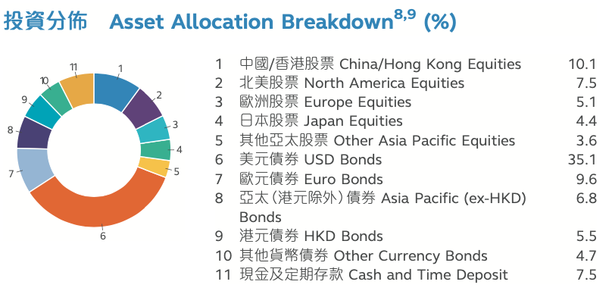
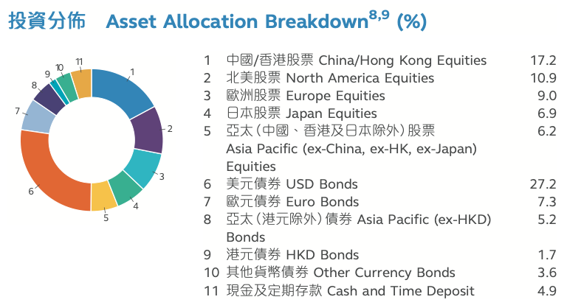
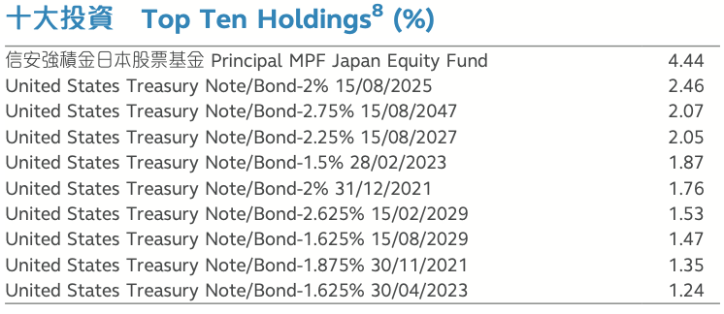
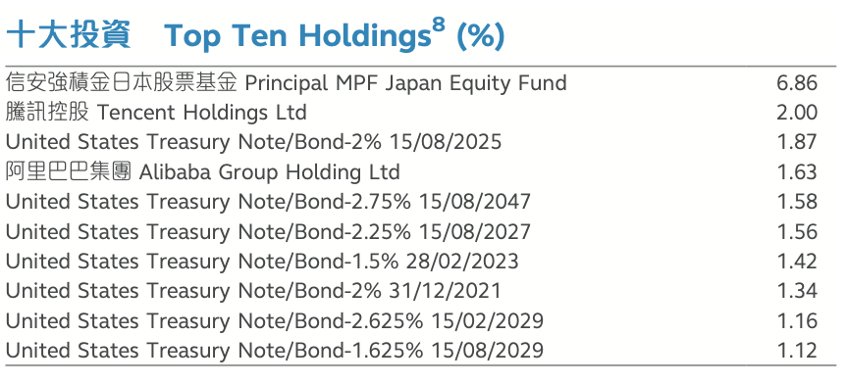
Fund Allocation & Holdings
PRISTYC HK Equity & PRILTAC HK Equity
Stable Yield Fund
Long Term Accumulation Fund

Slide 27
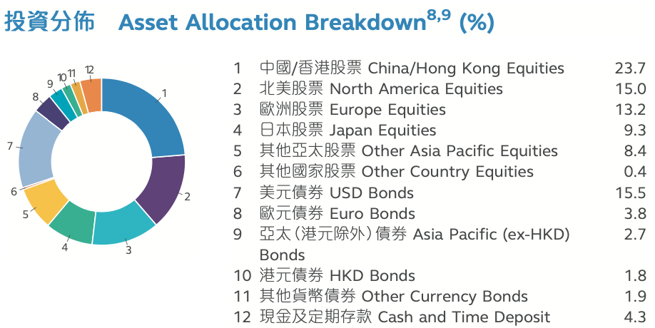
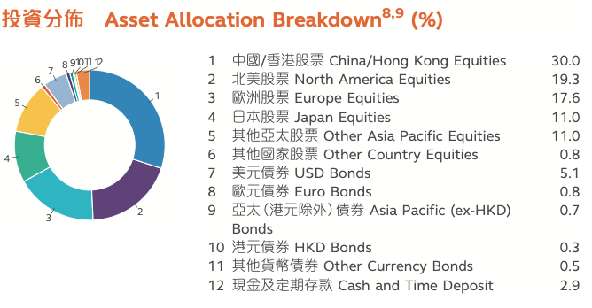
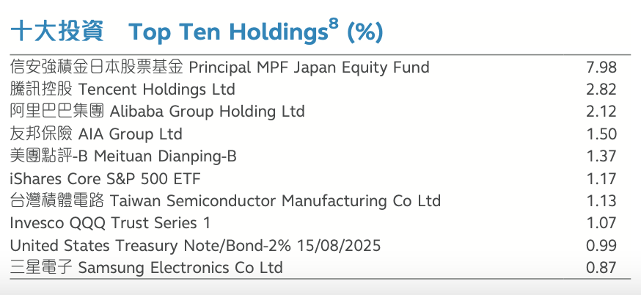
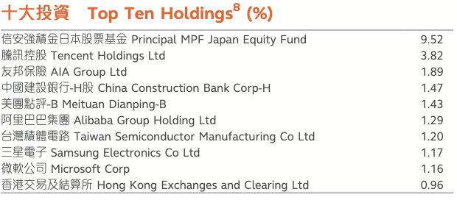
Fund Allocation & Holdings
PRIGLGC HK Equity & PRIAGSD HK Equity
Global Growth Fund
Aggressive Strategy Fund

Slide 28
Conclusion
Efficient Frontier helps build a Portfolio Allocation Model
3 functions for different purposes
With adequate backtesting and optimization
With the model built,
Average Error compare to testing data= 3.78%
Average annualized return compare to benchmark = +2.62%
Portfolio Return over 20 years = +72.45%
Compare to benchmark = +48.62%

Slide 30
Fund Allocation & Holdings
PRISTYC HK Equity
Stable Yield Fund

Slide 31
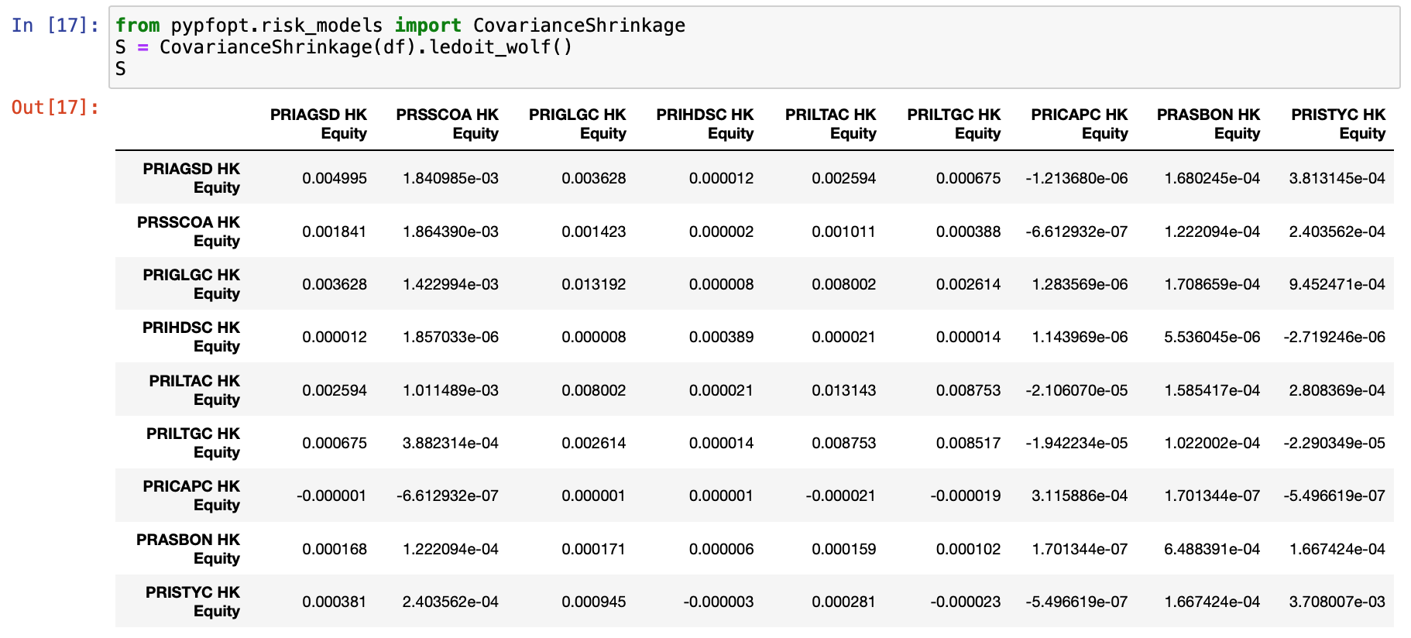
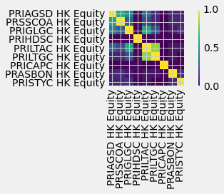
Covariance Matrix

Slide 32
Correlation
Result
However,
[PRISTYC HK Equity & PRIGLGC HK Equity]
[PRISTYC HK Equity & PRIAGSD HK Equity]
[PRISTYC HK Equity & PRILTAC HK Equity]
[PRILTAC HK Equity & PRIAGSD HK Equity]
are little correlated
Only
[PRIGLGC HK Equity & PRIAGSD HK Equity]
[PRILTAC HK Equity & PRIGLGC HK Equity]
are highly correlated

Slide 33
Fund Comparison
PRILTAC HK Equity & PRIGLGC HK Equity
Global Growth Fund
Long Term Accumulation Fund

Slide 34
Fund Comparison
PRIGLGC HK Equity & PRIAGSD HK Equity
Global Growth Fund
Aggressive Strategy Fund

Slide 35
Explanations on Significant Changes
Financial Crisis
2008
The stock market crash occurred on September 28, 2008.
Major financial markets lost more than 30% of their value
The funds were significantly affected by the stock market and their values decreased sharply.
2011-12
United States debt-ceiling crisis of 2011
The Growth Recession Of 2012 in US
US Presidential Election

Slide 36
Explanations on Significant Changes
Financial Crisis
2015-16
2015–16 Chinese stock market turbulence - 27 July and 24 August's "Black Monday”
2016 United Kingdom European Union membership referendum (Brexit)
pound ↓, LSE FTSE ↓, while US interest rates ↑
2020
Coronavirus crash was a sudden global stock market crash began on February 20 to April 7.
S&P 500, the Dow Jones Industrial Average experienced the largest one-day drop since the 2008 financial crisis.

Slide 37
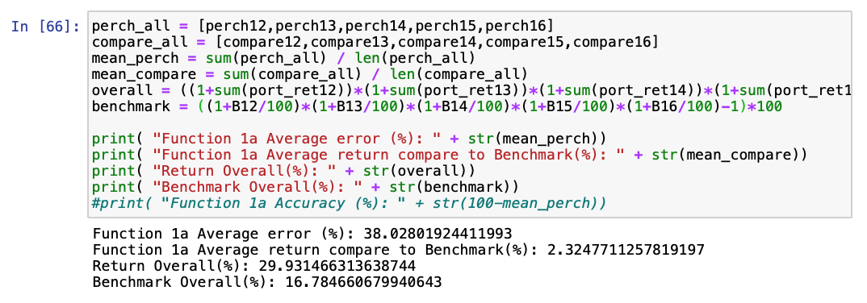
Data used
5 years validation data
5 windows
Include 2015–16 Chinese stock market turbulence, 2016 Brexit, 2020 COVID-19 crisis
High average error – 38.03%
Underfit

Slide 38
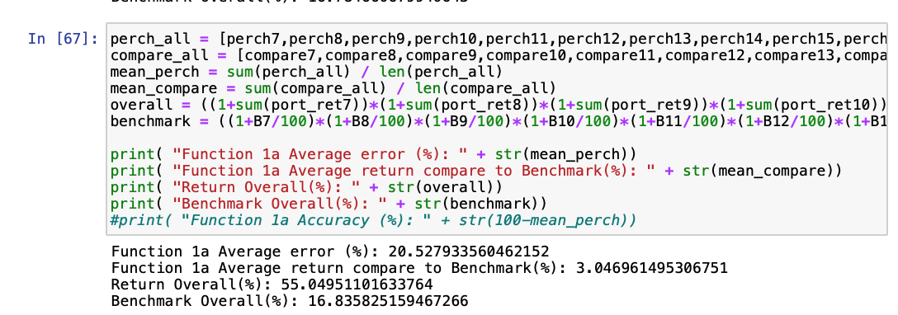
Data used
10 years validation data
More windows – 10 windows
Also include the United States debt-ceiling crisis of 2011
Lower average error – 20.53%,
but still high error
Underfit

Slide 39
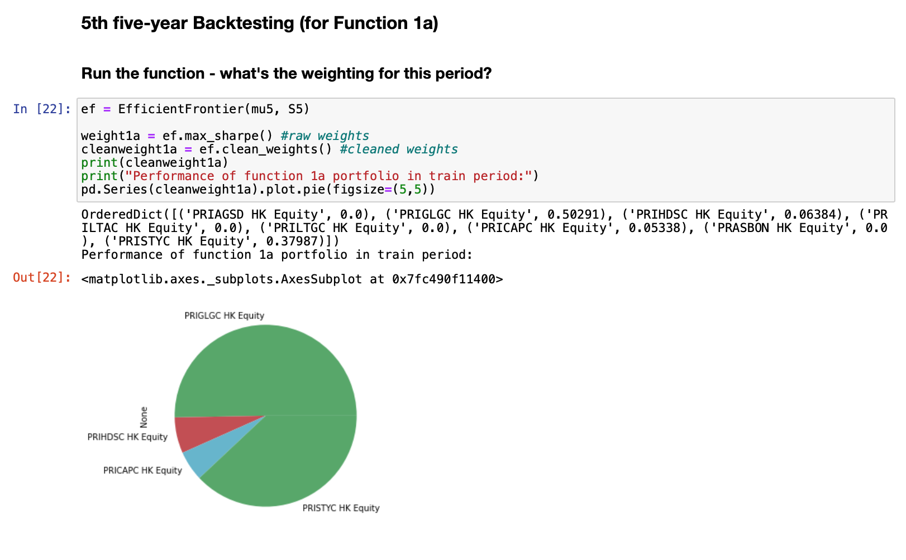
Backtesting and Optimization
5th window

Slide 40
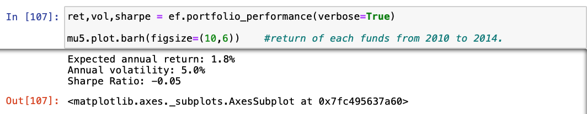
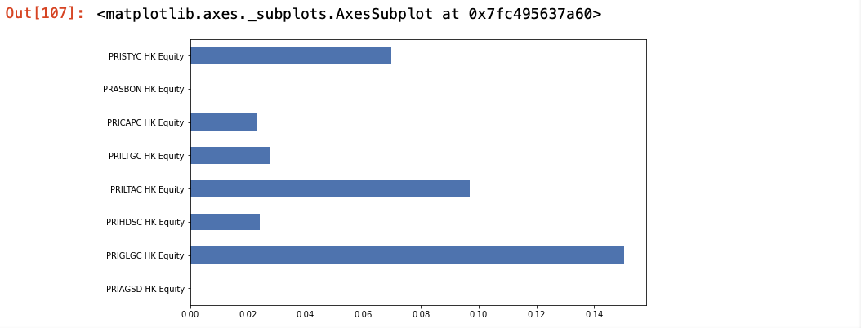
Backtesting and Optimization
5th window

Slide 41
Backtesting and Optimization
5th window

Slide 42
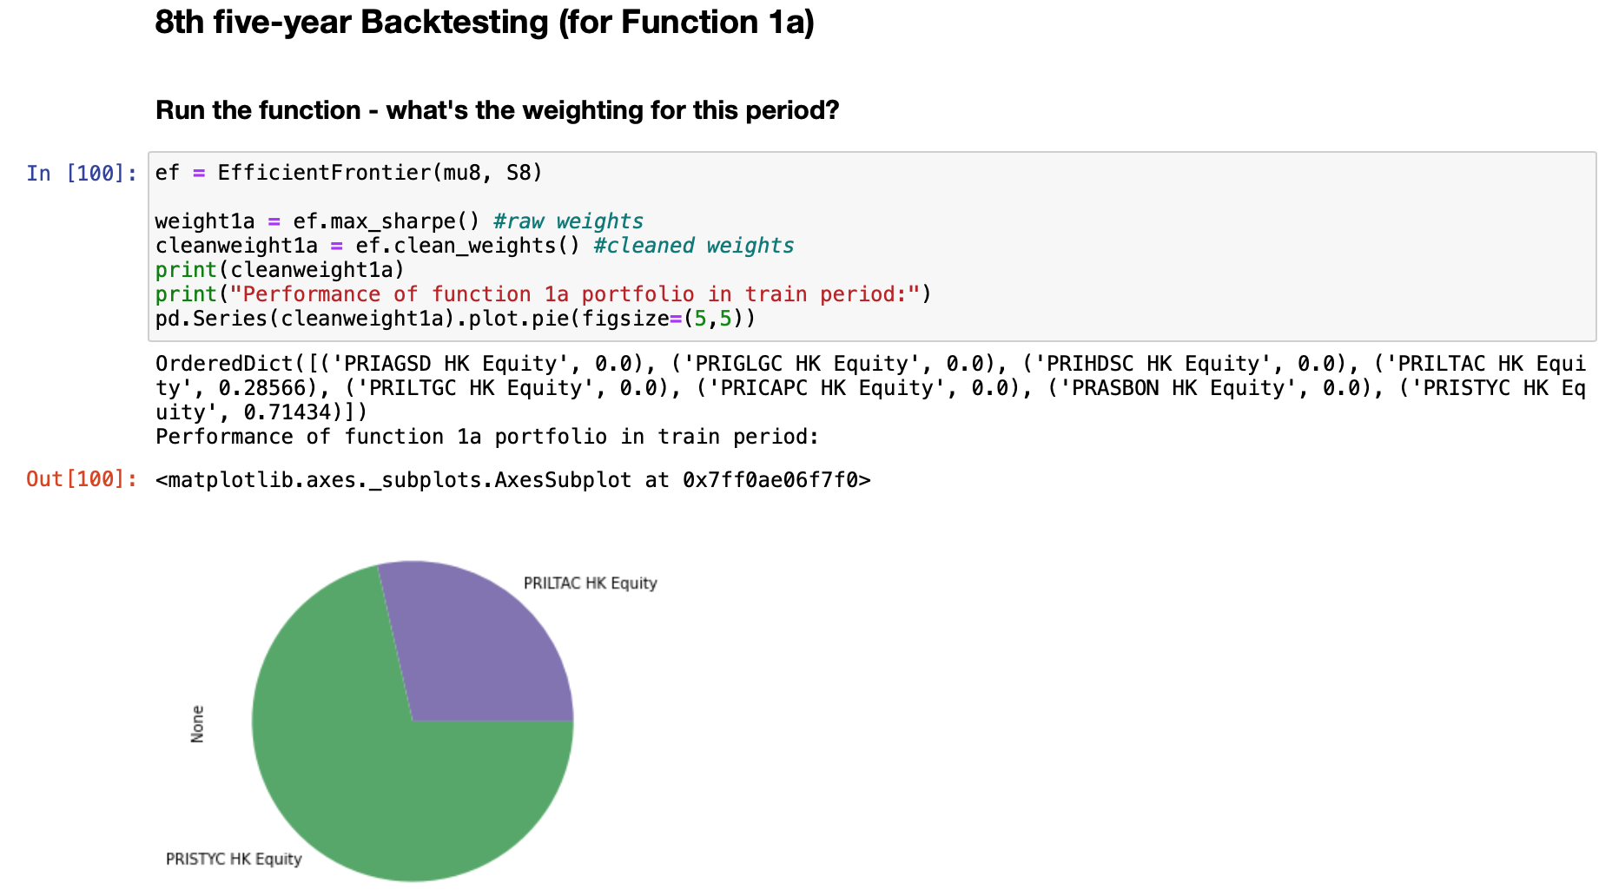
Backtesting and Optimization
8th window

Slide 43
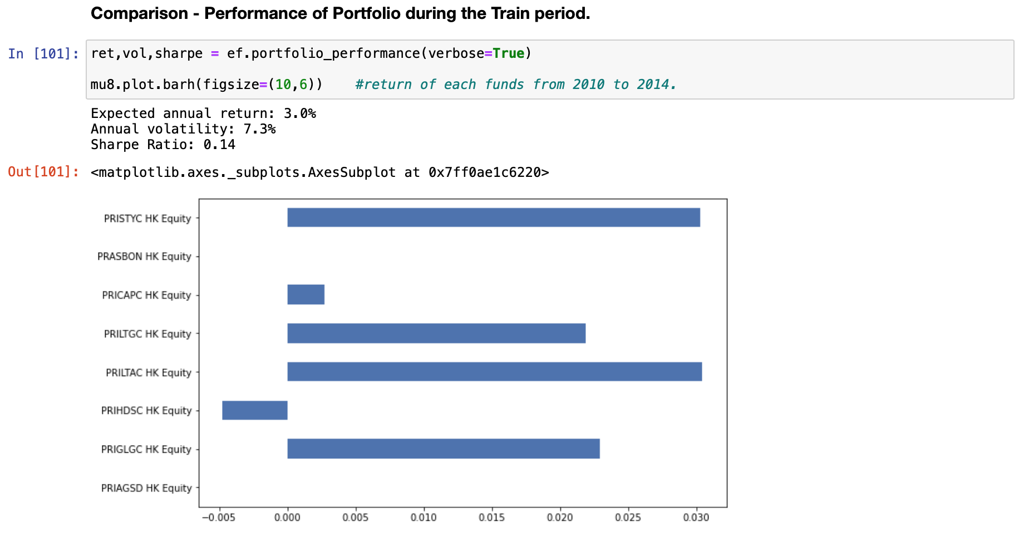
Backtesting and Optimization
8th window

Slide 44
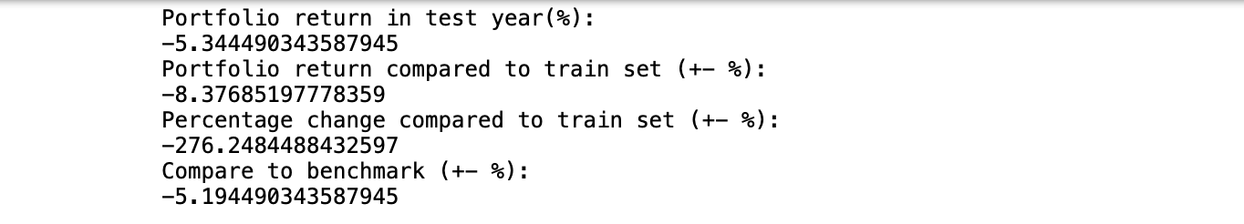
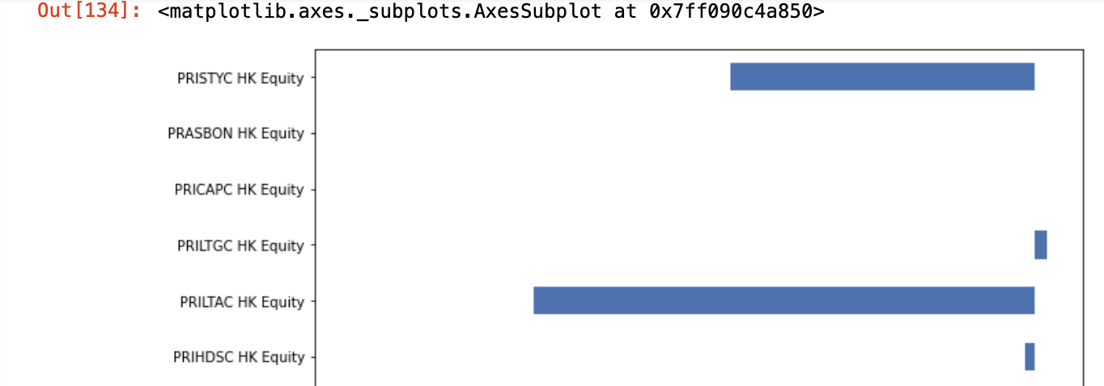
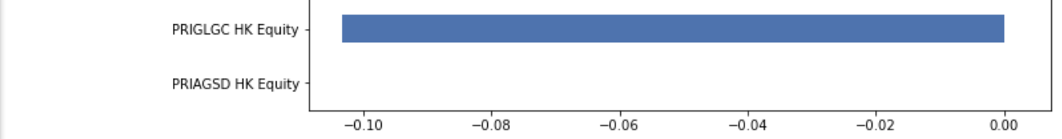
Backtesting and Optimization
8th window

Slide 45
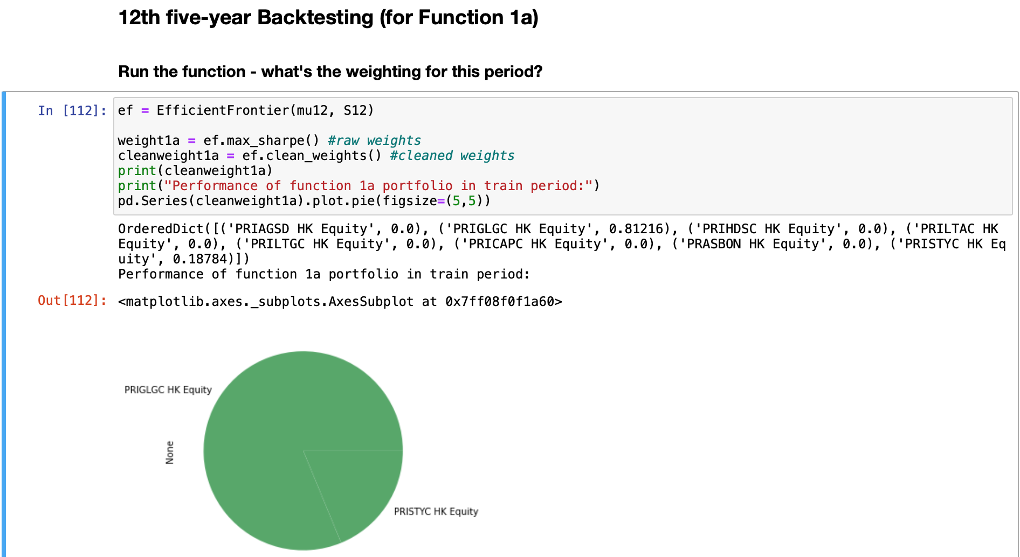
Backtesting and Optimization
12th window

Slide 46
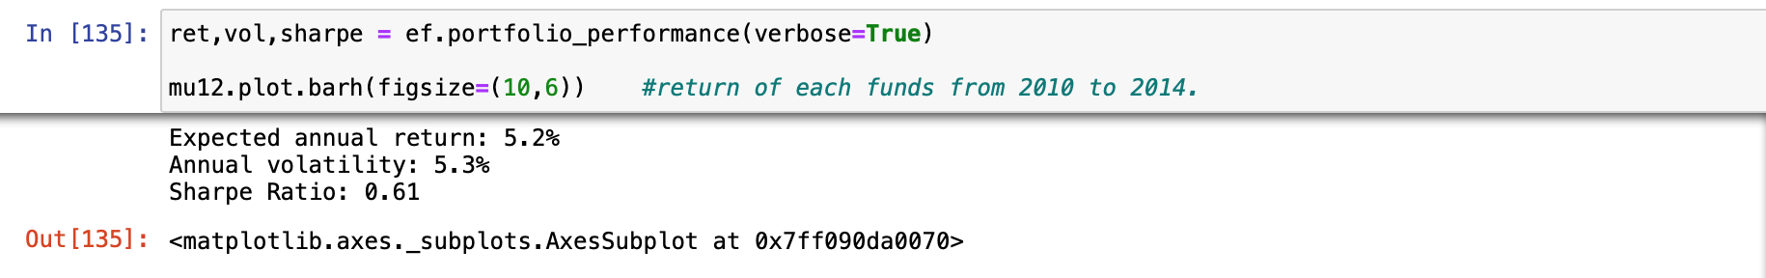
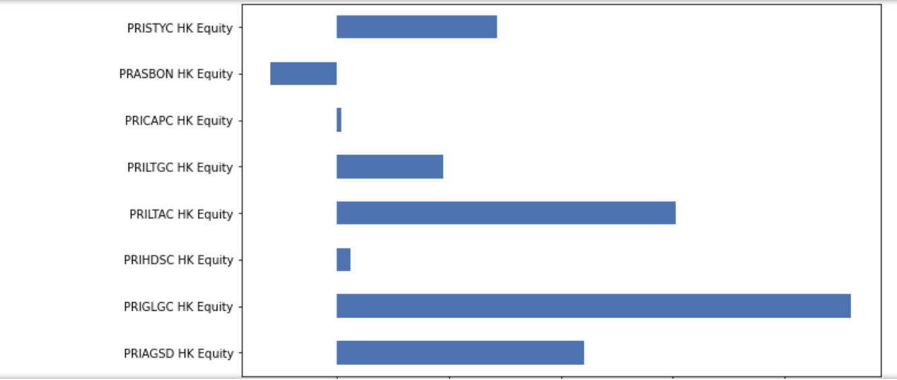
Backtesting and Optimization
12th window

Slide 47
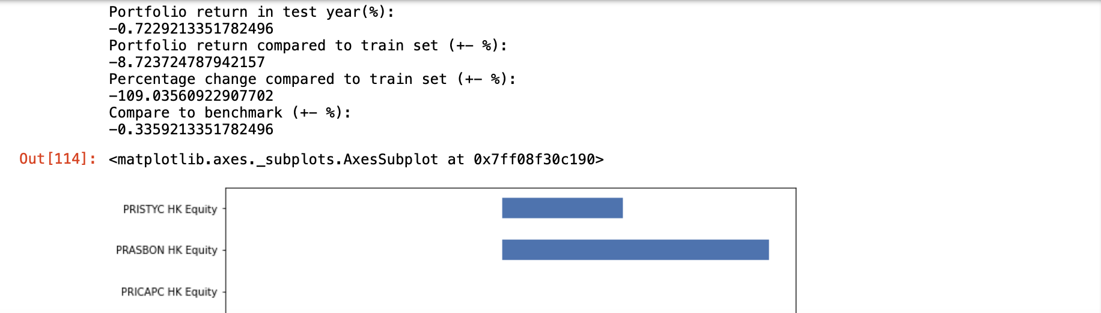
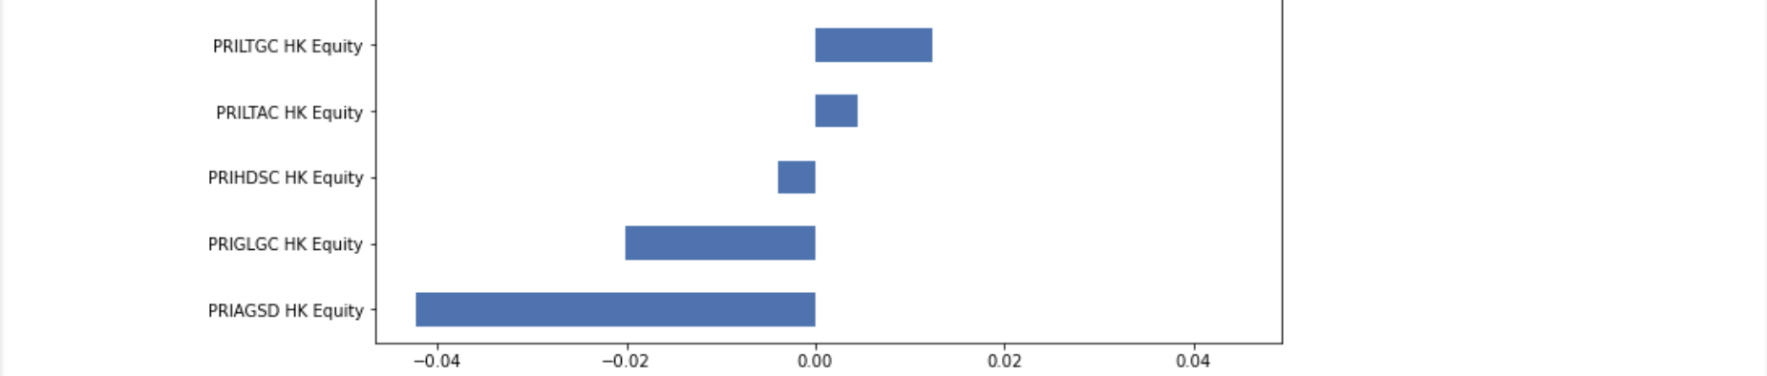
Backtesting and Optimization
12th window

Slide 48
Correlation
[PRILTAC HK Equity & PRILTGC HK Equity] are highest correlated
[PRILTAC HK Equity & PRIGLGC HK Equity] & [PRIAGSD HK Equity & PRSSCOA HK Equity] are highly correlated
However, [PRISTYC HK Equity & PRIGLGC HK Equity] [PRISTYC HK Equity & PRIAGSD HK Equity] are not highly correlated
[PRIGLGC HK Equity & PRIAGSD HK Equity] are slightly correlated

Slide 49
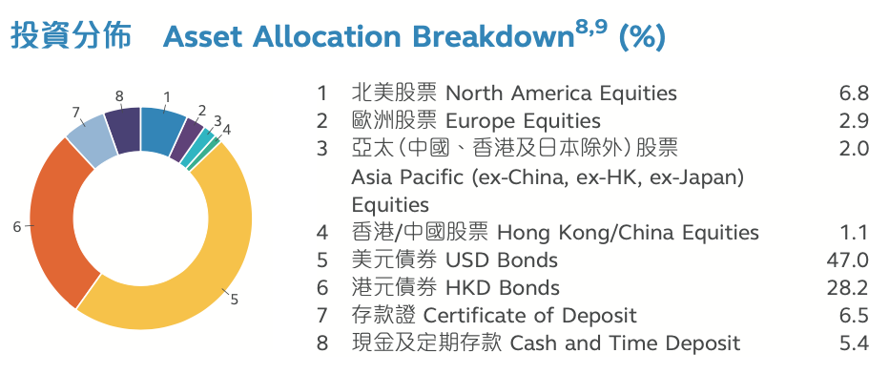
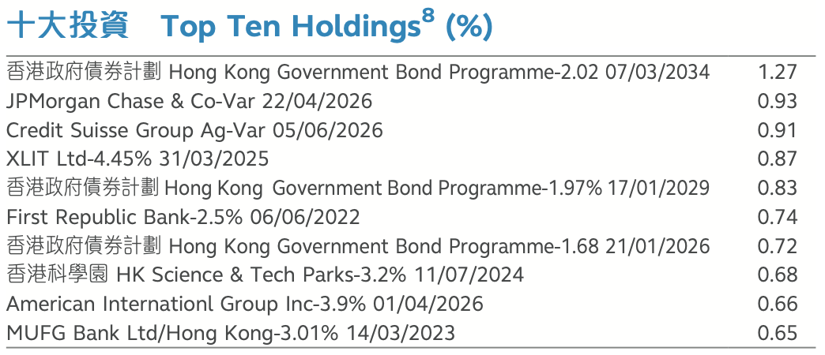
Fund Comparison
PRILTAC HK Equity & PRILTGC HK Equity
Long Term Accumulation Fund
Long Term Guaranteed Fund

Slide 50
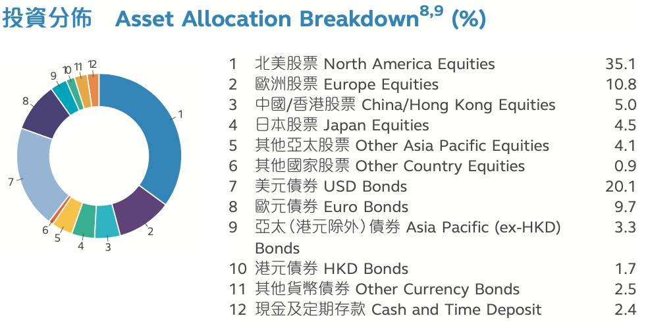
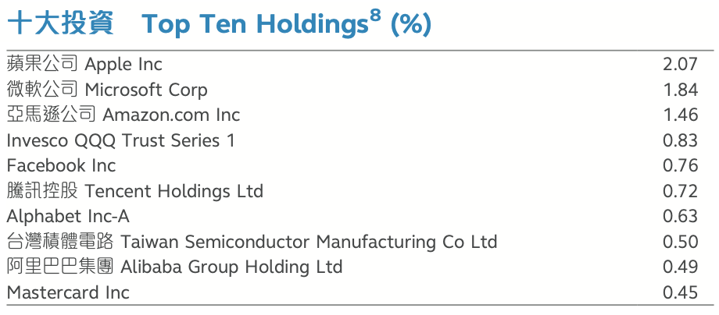
Fund Comparison
PRIAGSD HK Equity & PRSSCOA HK Equity
Aggressive Strategy Fund
Core Accumulation Fund

Slide 51
Fund Comparison
PRISTYC HK Equity, PRIGLGC HK Equity, PRIAGSD HK Equity
Stable Yield Fund
Global Growth Fund
Aggressive Strategy Fund

Slide 52
Future direction of improvements
Due to time constraint
More windows trial
from 3+1 to 2+1, or 3+0.5, but avoid overfitting
Compare the result with other models
Model trained with lightGBM, Prophet on Time Series
Find other Alternative data
Social media posts, scheme or fund reviews

